Slide 1





DATA STRUCTURE LAB
COURSE CODE: 0613-104
TALKSPACE
PRESENTED BY
PRESENTED TO
02. Mosaddek Hossain Mehedi
17. Saiful Islam
21. Hasibul Hoque Probal
22. Mst. Sultana Yeasmin Suma
40. Azizur Rahman Arzu
MOHIUDDIN HASAN
LECTURER
DEPARTMENT OF CSE
DHAKA INTERNATIONAL UNIVERSITY

Slide 2


1
INTRODUCTION
TalkSpace is a console-based chat system where two users take turns sending messages. The application stores messages in a file, displays the chat history and provides options to search, edit, delete, clear history and exit the chat. The project demonstrates basic programming concepts such as user input, loops, arrays and vectors, file handling and string manipulation

Slide 3
2
DEPLOYED FEATURES
Bi-polar conversation between users.
Unique username for users.
Saving Chat History: Sent messages are stored & displayed.
Clear History: Users can clear the chat history during the chat session.
Exit conversation: The chat session can be ended by typing ‘exit’.
Search Messages: Specific text can be found using the ‘search’ command.
Edit Message: Last message can be edited by typing ‘Edit’.
Delete conversation: Last message can be deleted by typing ‘delete’.

Slide 4

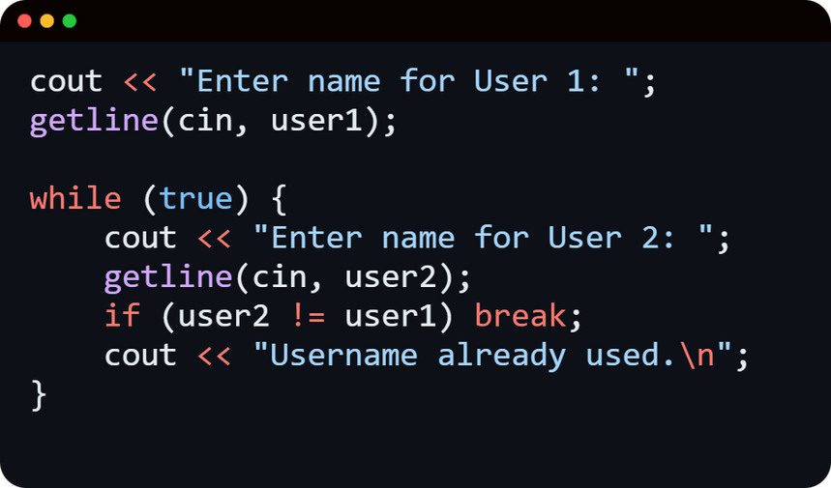

FEATURES OVERVIEW
Custom Username
3
int main() saves the custom username using Loop statements for further use.

Slide 5
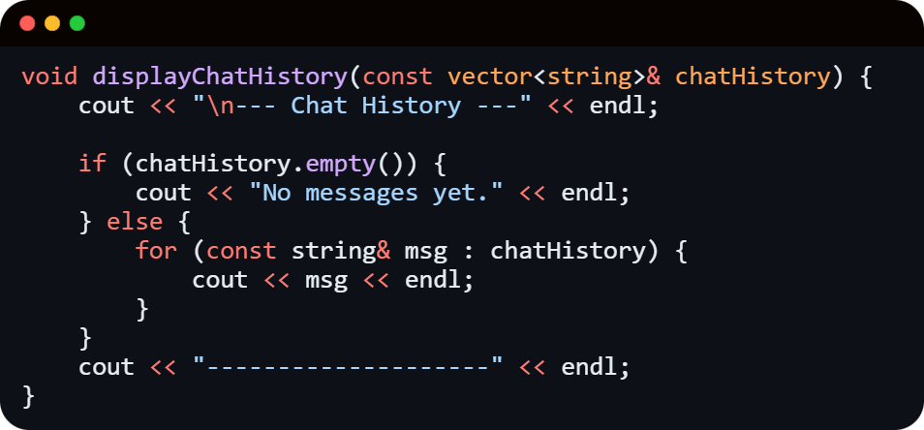
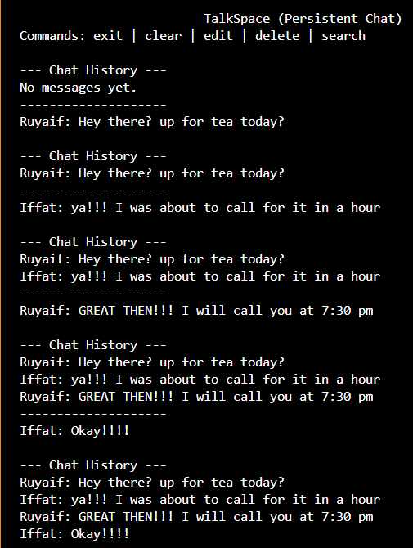
FEATURES OVERVIEW
Display Chat History
4
displayChatHistory() displays the chat history stored in an array.

Slide 6
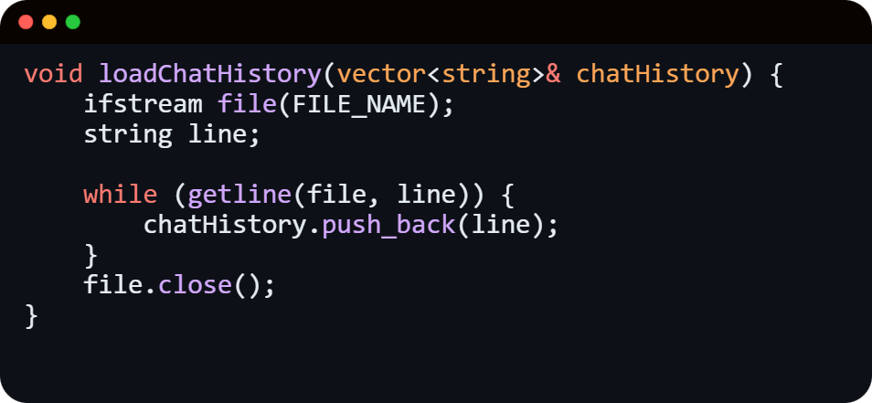
FEATURES OVERVIEW
Loading Chat History
5
loadingChatHistory() loads previous messages from the saved chat history.

Slide 7
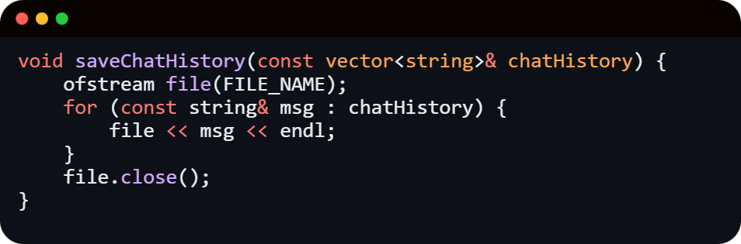
FEATURES OVERVIEW
Saving Chat History
6
savingChatHistory() saves sent messages to the chat history.

Slide 8
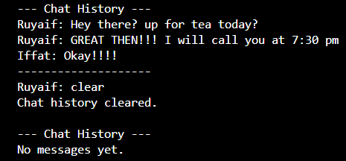
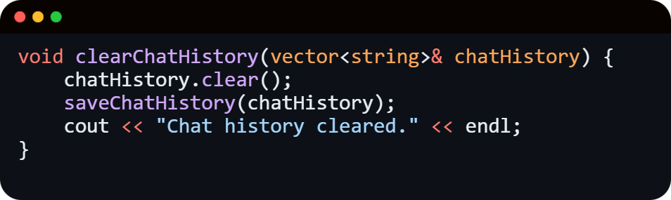
FEATURES OVERVIEW
Clearing Chat History
7
clearChatHistory() clears the chat history by resetting the message count.

Slide 9
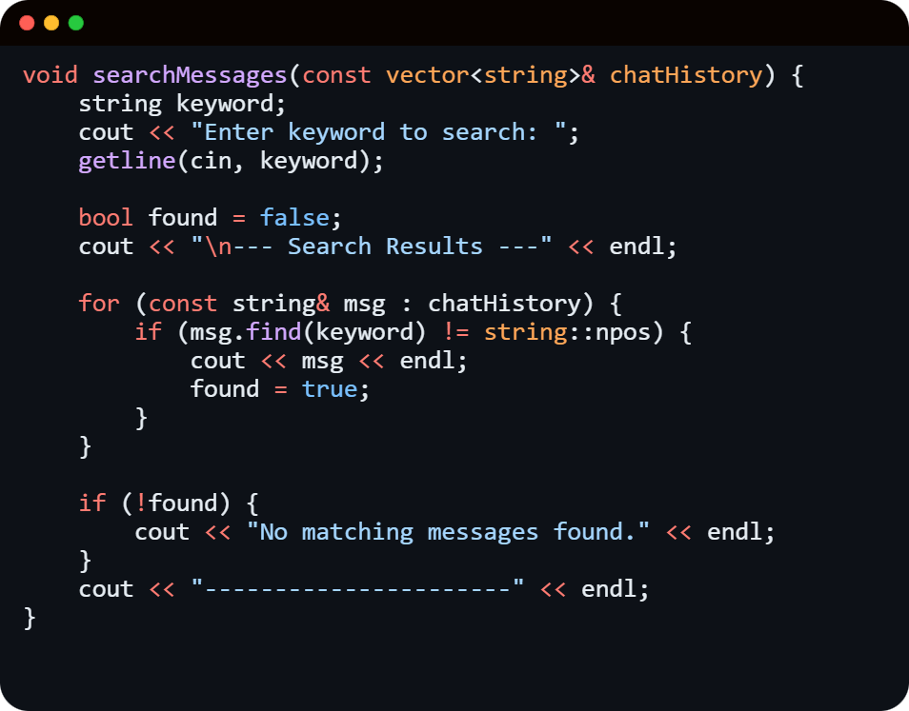
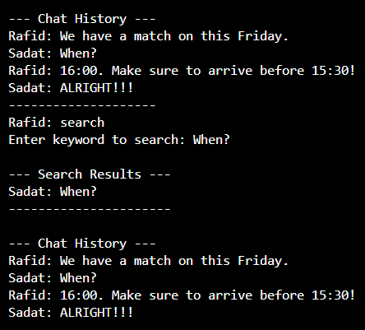
FEATURES OVERVIEW
Searching text
8
SearchMessages() searches specific text from the conversation using getline function, loops & conditional staement.

Slide 10
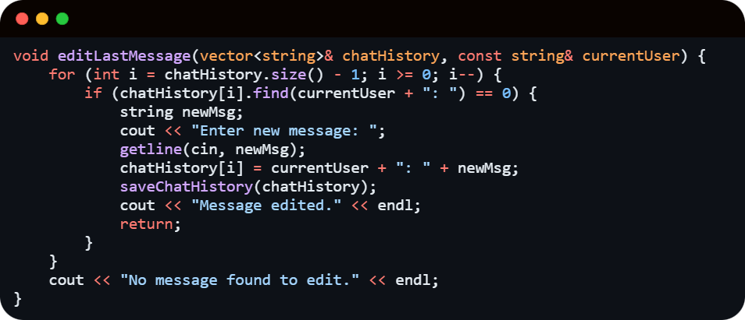
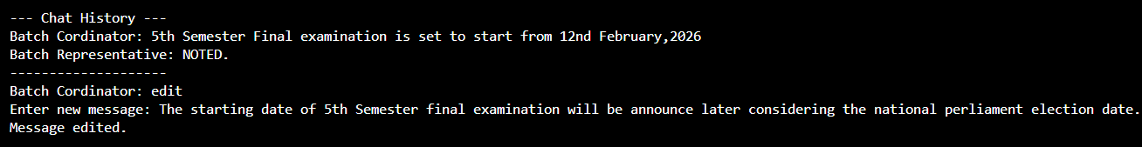
FEATURES OVERVIEW
Edit the last message
9
editLastMessage() edit the last message using string, constant, getline function & loop statements.

Slide 11
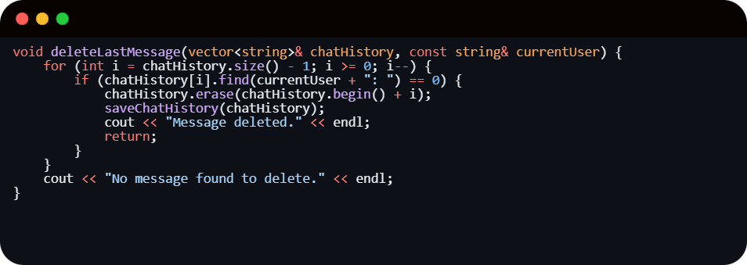
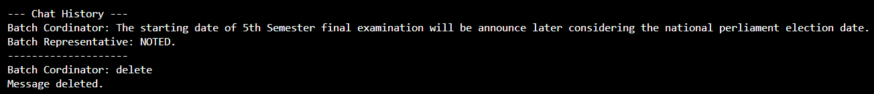
FEATURES OVERVIEW
Delete the last message
10
deleteLastMessage() edit the last message using string, constant, getline function & loop statements.

Slide 12
11
CONCLUSION
The​‍​‌‍​‍‌ project implements a minimal chatting system for 2 users, with features like: saving conversations, searching message, editing & deleting message, clearing chat history & logging out sessions.

Slide 13


ANY QUESTIONS ?

